Slide 1
Tibetan Flags

Slide 2
ORGANIZER: I.C.S.FALCONE S.G.LA PUNTA (CT) ITALY & SECONDARY SCHOOL „OLTEA DOAMNA” ORADEA ROMANIA CONTACT NAME: IRENE CONFALONE & MIRELA TANC CONTACT EMAIL: ireneconf@hotmail.com
mirelatanc@yahoo.com

Slide 3
"European Day of Languages is a manifestation celebrating linguistic diversity, multilingualism and language learning throughout life.

Slide 4
The main objective of this event is drawing the attention of students on the importance of native and foreign language learning, but also raise awareness of the existence and value of languages spoken in Europe, encouraging their learning. The activities that we have organized stimulated students' interest in European countries and European linguistic diversity "

Slide 5
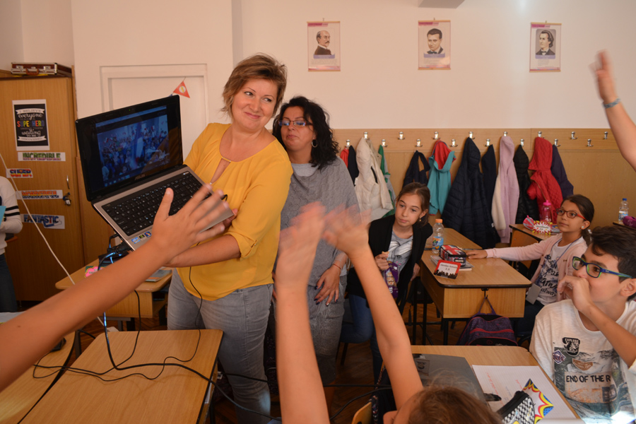

Slide 6
5th grades A and C of the Secondary School,, OLTEA DOAMNA "Oradea, Romania, coordinated by Mrs. prof. Mirela Tanc and students from the Istituto Comprensivo,, G. FALCONE", coordinated by Mrs. prof. Irene Confalone in SAN GIOVANNI LA PUNTA, Sicily, Italy and presented in parallel, directly, through Skipe, Tibetan flags with messages of peace and friendship. The surprise of the conference was that Ms. teacher, Irene Confalone. with her school, involved in transmitting messages to Romanian students. The activity was recorded on the official website of European Day of Languages

Slide 9
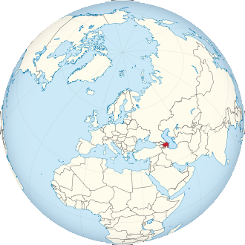

Slide 10
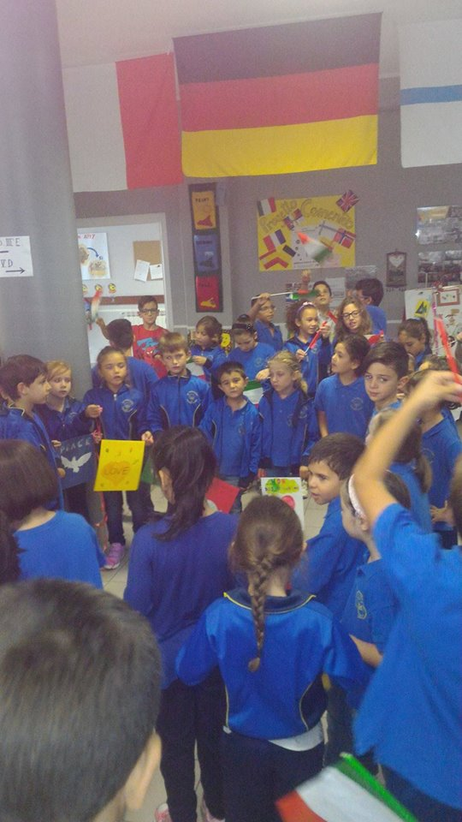
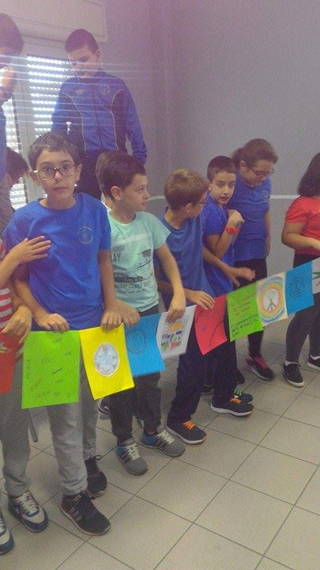

Slide 14
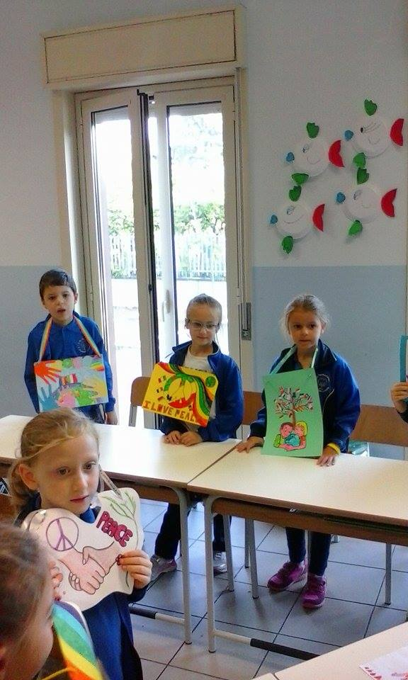

Slide 15
Notes:
True: c+d

Slide 16
All the students were very happy to participate in this great project!

