Slide 1
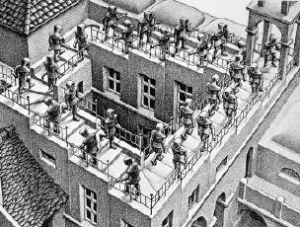
Let’s meet M.C. ESCHER…

Slide 2
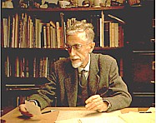
Let’s meet M.C. ESCHER…
Maurits Cornelius Escher, dutch artist and
mathematician (1898 -1972)
After his architecture studies, he travelled in Italy. He lived in Swiss, Belgium and Oland.
He loved mathematics and geometry
While still a boy he enjoyed arranging slices of cheese on his big slice of buttered bread in order to cover it completely, leaving no gaps.

Slide 3
Let’s meet M.C. ESCHER…
MATHEMATICAL STUDY
TESSELLATION
NEW WORKS
Revelation were the wonderful decorations of the Alhambra in Granada
(Autumn 1922)
Escher was able to create new works starting from the mathematical study and the most famous tessellation. He combines together the various pieces of its curious mosaics.

Slide 4
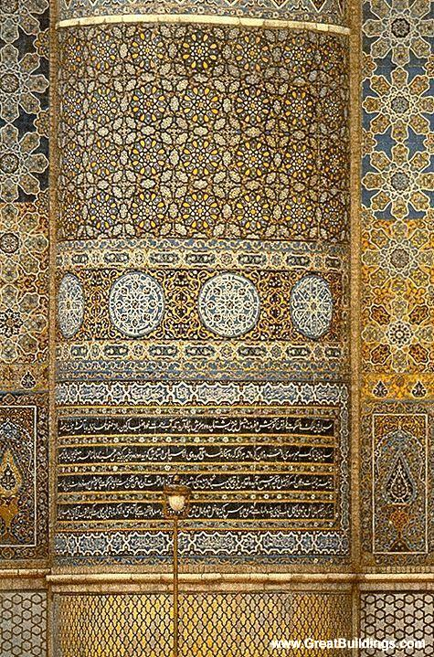
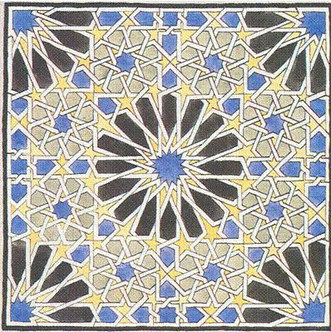
Let’s meet M.C. ESCHER…

Slide 5
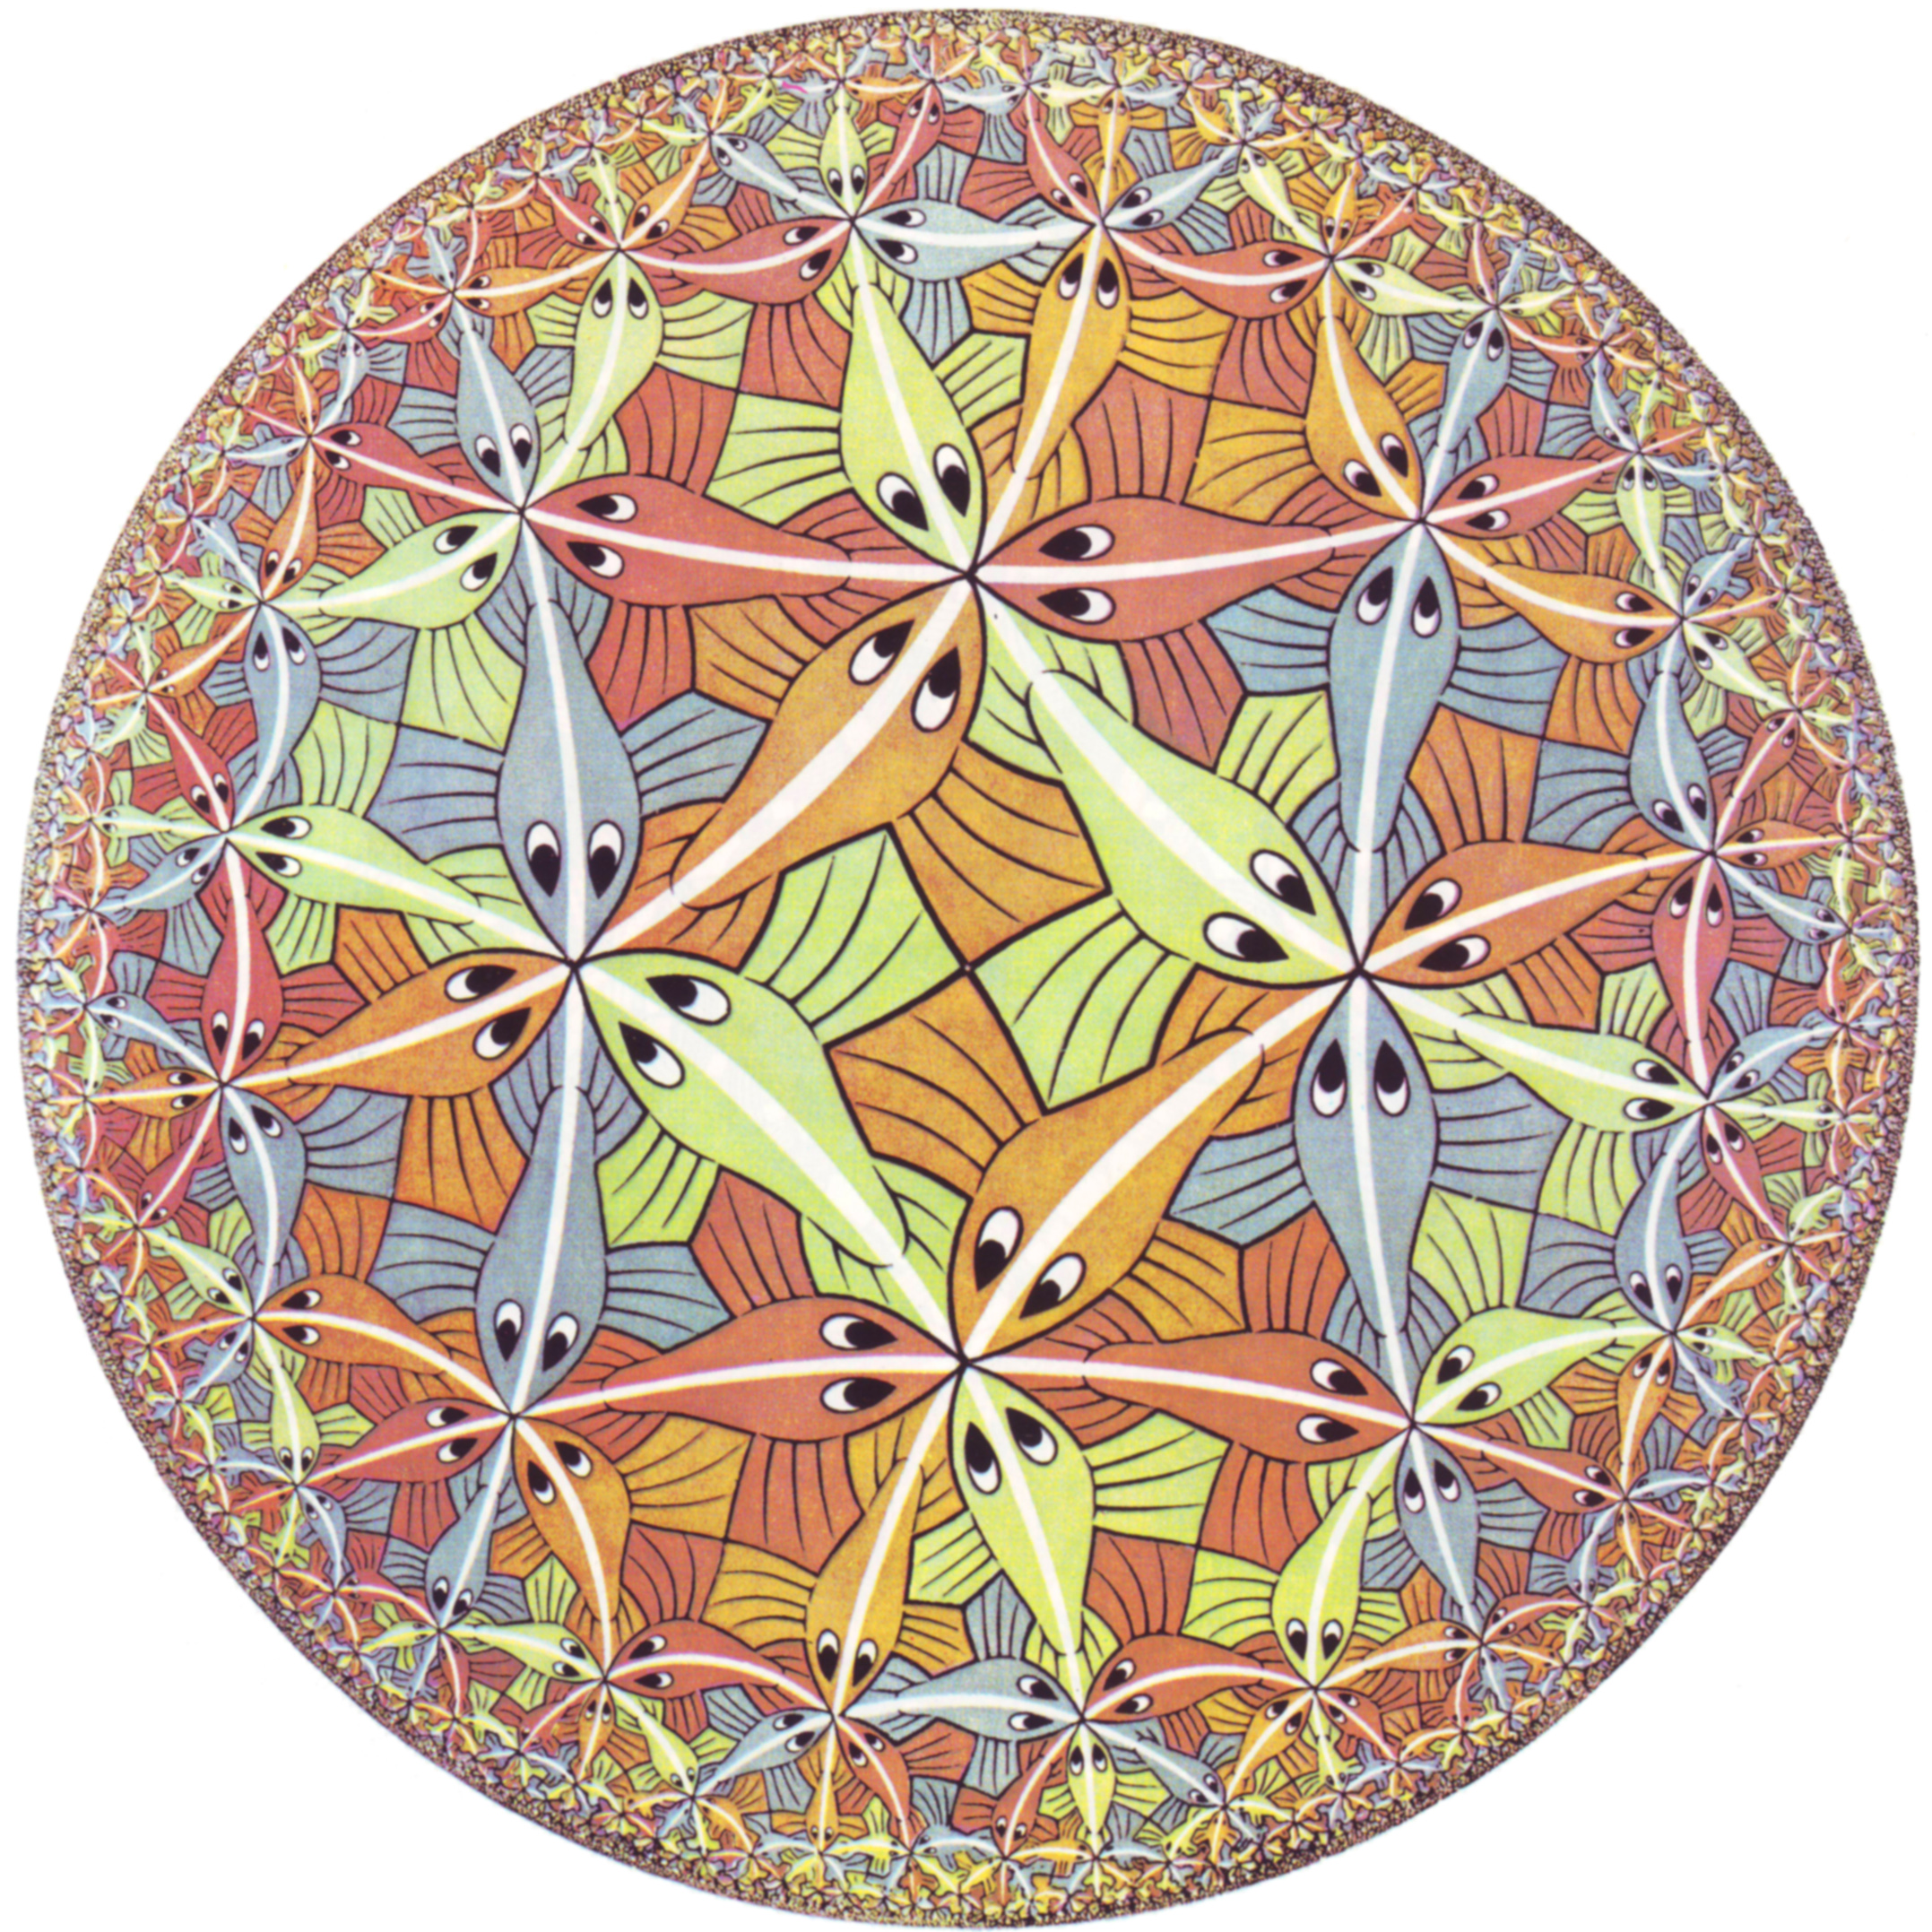
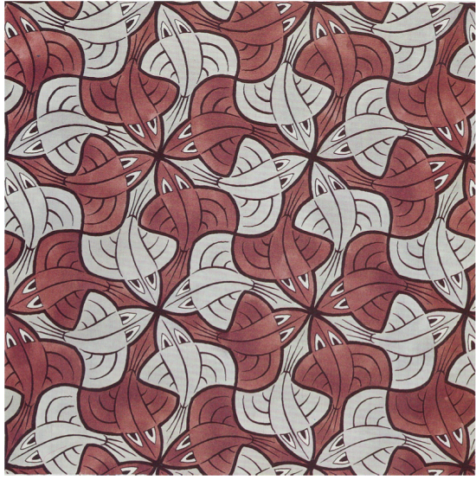
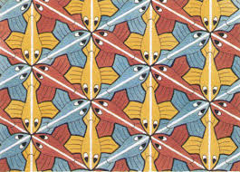
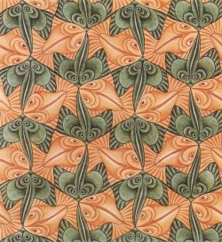
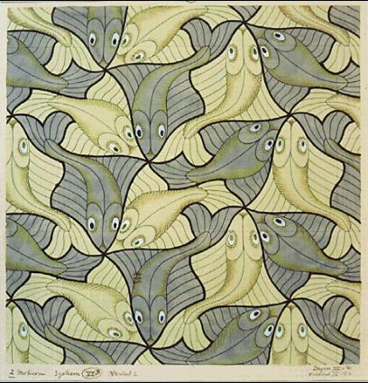
Let’s meet M.C. ESCHER…
Tesselletion
Two and three-dimensional with all possible variations of shape and size.

Slide 6
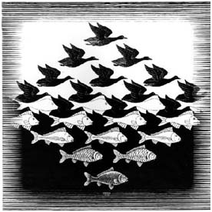
Let’s meet M.C. ESCHER…
Tesselletion with white and black spaces

Slide 7
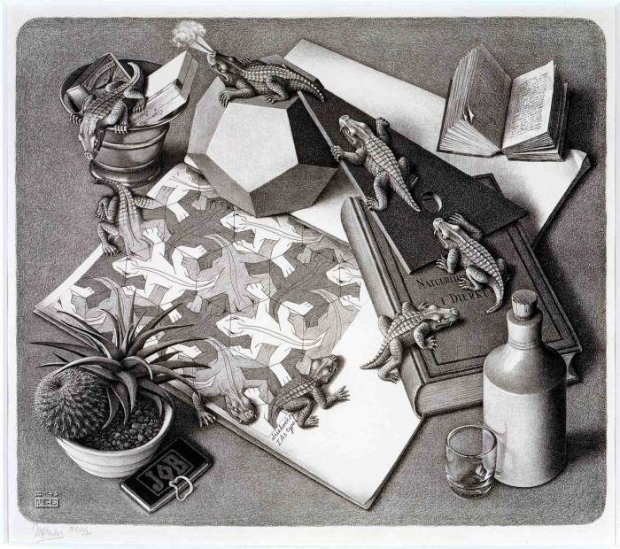
Let’s meet M.C. ESCHER…
Self reference like the lizards coming in and out from sheet where they are drawn

Slide 8
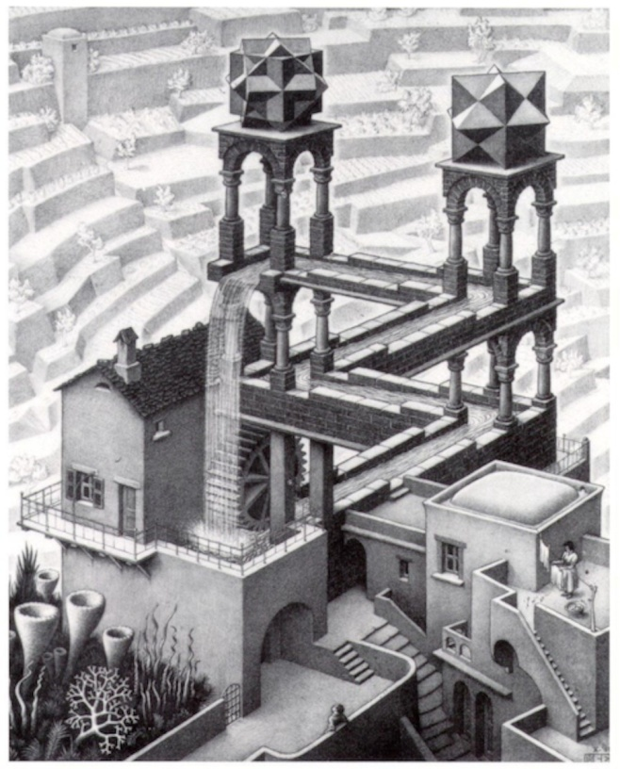
Let’s meet M.C. ESCHER…
Perpetual motion

Slide 9
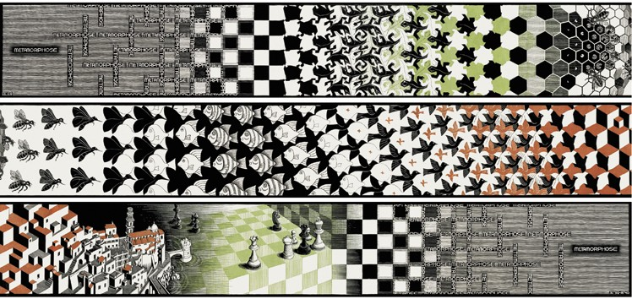
Let’s meet M.C. ESCHER…
An image changing…and reality
8 m

Slide 10
Let’s meet M.C. ESCHER…
WORKING on Escher
Who ? He is a Dutch mathematician artist. He was born in 1898 and died in 1972. He has traveled extensively and during these trips was inspired to become an artist
What?
He created several works in which His love for art and mathematics is present. His works have certain characteristics:
- Tessellation;
the movement;
the Self reference.
Where?
He was inspired by his travels in particular the one in Spain, Granada
When? In 1922 in Granada, visiting the Alhambra, decides to create works by bringing together art and mathematics

