Slide 1
"Reuse school objects, create new toys"
ICS. « FALCONE »
SAN GIOVANNI LA PUNTA – CATANIA
ITALY
Prof. Irene Confalone

Slide 2
That’s me
I’ m Irene Confalone
I teach in a primary school in the southern part of Italy .In a beautiful island called Sicily. I’ve been teaching English since 1991 .I ‘ve been the coordinator of several Erasmus projects of my school .I’m etwinner since 2012 .I’m a MIE , MIEE and Mistery Skype Teacher .
I love my work and I love travelling because I like to open my arm to new cultures.

Slide 3
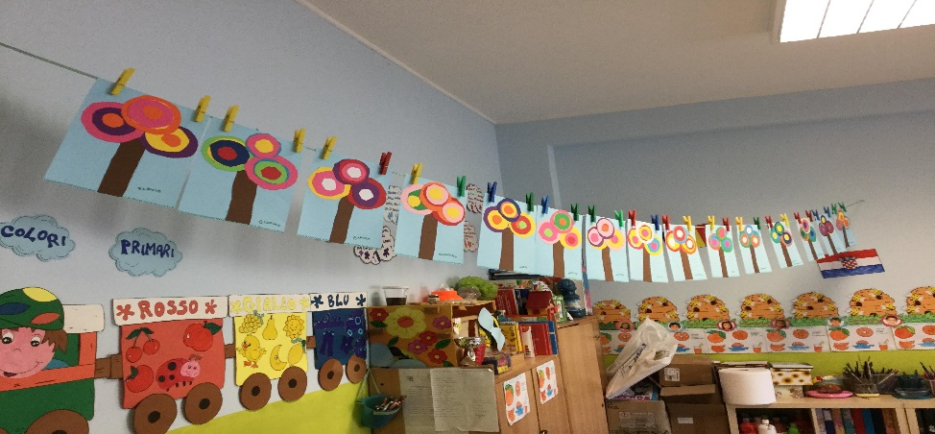
ICS. «FALCONE»
"Giovanni Falcone" is an institution with kindergarten, primary and secondary school, which is located 10 kilometers far from Catania . Our institution is located in a socio-economically disadvantaged area. Despite the opening of a big shopping center, the unemployment rate is still very high. Moreover, in our school there are a lot of pupils with disabilities: some of them are integrated in the classes of normal children. In our school there are 1200 pupils aged between 3-13 years.

Slide 4
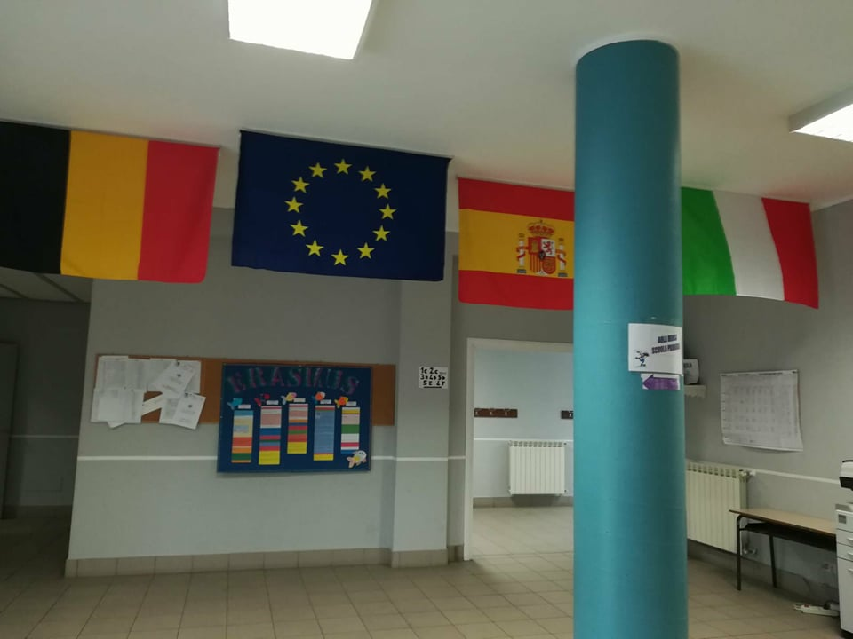
Falcone school
. Our institute develops a teaching aimed at providing its students with skills required at ministerial level. In the logical-scientific field, the work, in the different school orders, is aimed at the development of problem solving and the use of IT systems as an aid in study activities. We develop the internationalization as a mutual aim of the school to open our students’ mind and heart.

Slide 5
Falcone school
. In particular, unplugged and computer programming activities are carried out (via the code.org website and the Scratch application). These concepts are then put into practice with robotics activities structured appropriately for the age of the pupils (Bee-Bot, Lego We Do 2.0, Lego Mindstorm).
This school received the eTwinning School label in 2018/19 and we received the School Label for the current year 2020.We received 6 European Quality Labels and 4 National Quality Labels from 2012 to now.

Slide 6
The project
Etwinning project and Climate Action Project
Level : From 5 to 9
Key competencies : Civic / Cultural awareness and expression
Subjects : Art / Citizenship / Cross Curricular / Environmental Education / Geography / Music/ History / Primary School and kindergarten

Slide 7
The idea
Plastic pollution is a problem throughout the world that causes problems in our towns, cities and oceans because it causes so much harm and so much mess. We would like to work with people who want to explore ways to tackle the problems that plastic brings to our community by getting the children to research alternative ways of using plastic and different ways of packaging everyday items.

Slide 8
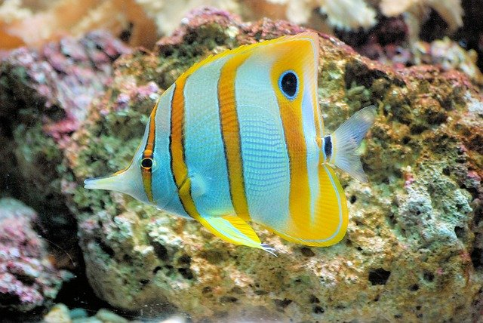
We want to change the world
The children were challenged to put bottles and other plastic school objects to better use by creating something else through them as toys… Recycling… …What we can do?
We started from
the idea of a fish…

Slide 9
Pedagogical aims
- To raise awareness of environmental problems - To develop their critical thinking by being able to provide solutions - To become active citizens and make their voices being heard - To organize their work and be able to work in international teams - To learn about pollution by conducting science experiments - To build a strong environmental awareness and consciousness by creating new toys to play.

Slide 10
Activities
The students are divided in 2 teams): Teams of different age (youngest and eldest). Each team worked on different activities Each team :one creating the new toys ,the eldest creating the instruments. • Review vocabulary terms dealing with their topic (• Collect informative material ) • Invited experts and visit organizations dealing with the topic • Make experiments to understand better the type of pollution they are dealing with
• Agree on specific activities and campaigns that students can organize locally

Slide 11
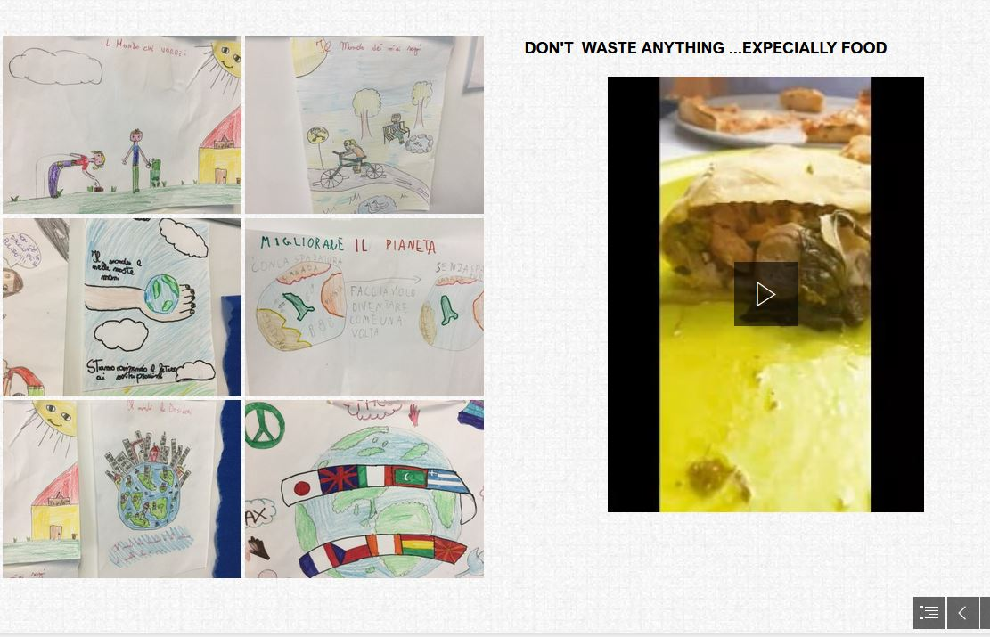
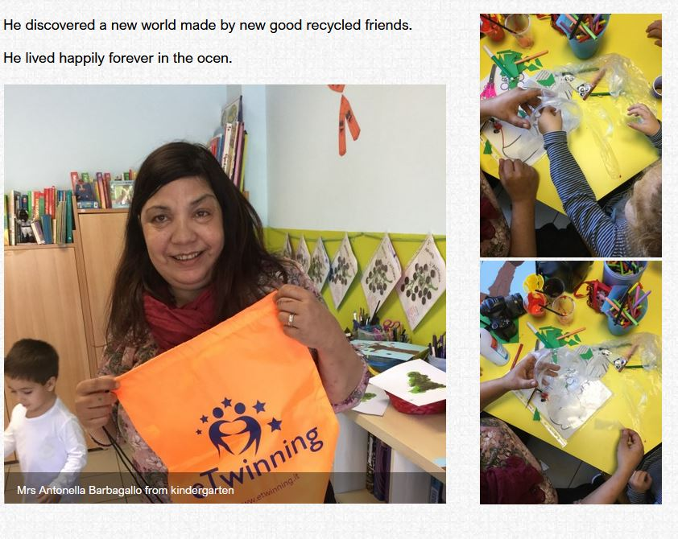

Slide 13
Collaboration
The teams worked on the above activities and organize meetings to present their results to the other teams. All teams worked on creating: • info sheets with their main findings about their type of pollution (Science, Art and ICT teachers) • short informative videos (Language and ICT teachers) • posters with easy steps that every student can do to help to have a pollution free sea (Science, Art, Language and ICT teachers) The teams also worked collaboratively to write a collaborative story on a topic like: Every student has to add at least one sentence to the story. The school organized an event in their school where they will invite local authorities, parents and environmental organizations. For the organization of this, they can also involve other classes. During this event, the schools can connect online and share their work, they can have a display all of their posters they created, they organized sessions to play the board games with other students and host small debates on the topic. They closed the event with one action: cleaning a nearby yard park of the school. Tools: Writing Words, Genially, Easel.ly, Voki, Vocaroo, Storyjumper.

Slide 14
Comunication
Students have been asked to make a drawing or the pollution issues in our planet . In an online meeting, the partner schools met and introduced each other and discussed their feelings and fears about the future of the planet.

Slide 15
Evaluation
Students evaluated their work at different stages of the project. Working in different teams and presenting from time to time their work and toys to the other classes and gave them the feedback they need to continue their work.
"Reuse school objects,create new toys"

