Slide 1
Erasmus+
Using ICTs to meet other young Europeans
September 16, 2020

Slide 2
Presentation of the coordinators
Thierry Hennico
Irene Confalone
Janja Žnidarić
Marcos Domenech
Elisabeth Desbois

Slide 3
Thierry
I was born in 1963. Dad of two grown children (28 and 26) I have been with my wife Brigitte for 39 years. Married for 31 years today! I have been a teacher for children aged 10-12 for most of my career. I worked with children with special needs for 3 years at the start of my career. I have been living on Comenius, Erasmus and eTwinning projects since 2011.
Hobbies : travels (Marrocco), garden and basket

Slide 4
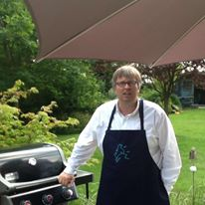
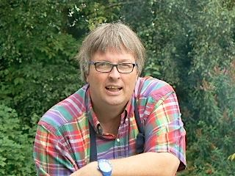
Thierry

Slide 5
Irene

Slide 6
Janja

Slide 7
Marcos

Slide 8
Elisabeth

Slide 9
The schools
E10172207 I.C.GIOVANNI FALCONE ItaliY
E10168534 Osnovna skola Sracinec Croatia
E10059986 Nuestra Señora de la Consolación Spain
E10111928 Collège Alexandre MACAL France

Slide 10
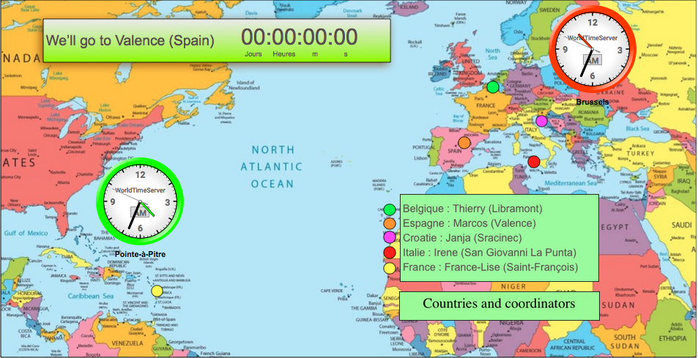
The countries

Slide 11
Budgets
Nuestra Señora de la Consolación Espagne : 28.533,00 EUR
Collège Alexandre MACAL France : 42.920,00 EUR
Institut Saint Joseph Belgique: 36.129,00 EUR
Osnovna skola Sracinec Croatie : 28.533,00 EUR
I.C.GIOVANNI FALCONE Italie : 28.533,00 EUR
164.648,00 EUR

Slide 12
Budgets
Project management and implementation : 6000 EUR
Project management and implementation : 12 000 EUR for Belgium
The rest of the budget must be devoted to mobility. Please note that if the mobility is not carried out, this budget must be reimbursed.
For the 6000 EUR, the money will remain acquiesced unless our end-of-project evaluation is poor!

Slide 13
The timetable

Slide 14
The timetable

Slide 15
Communication
P1
Page 10
Website
eTwinning
Emails
Facebook

Slide 16
Communication
P1
Page 10
Website
As described in the project, we must use a professional company to create this site. I have an appointment on Friday with a company that is going to create a site. This site will have the advantage of having a part in which we can add information ourselves. Each coordinator will therefore be responsible for bringing the site to life ... Proposition : the cost of 600 € will be shared by each country at the rate of 100 €. Belgium will pay € 200 as we get more money. What site name?

Slide 17
Communication
P1
Page 10
eTwinning
We have an obligation to use this platform. A group already exists but we have to adapt the eTwinning project into an Erasmus project. Who can take care of this?

Slide 18
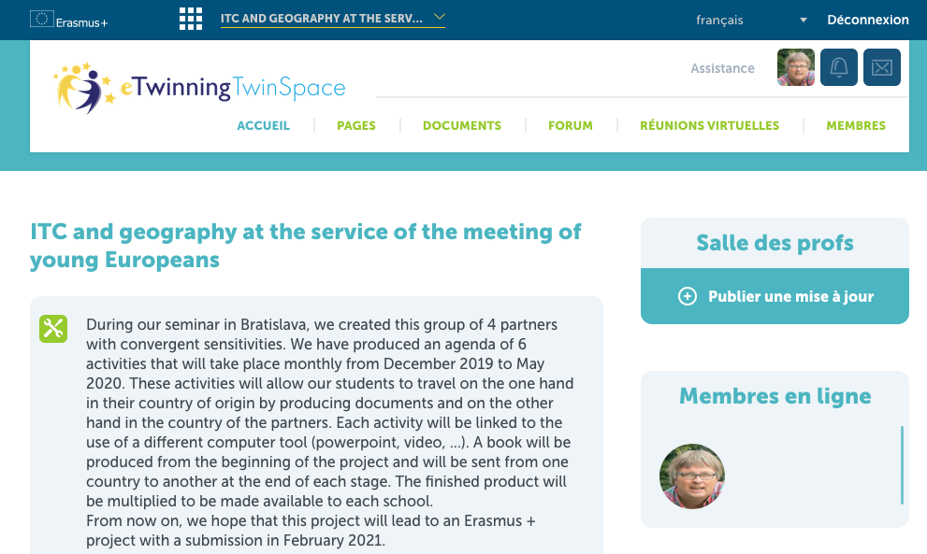
Communication
P1
Page 10

Slide 19
Communication
P1
Page 10
Emails
For all official information we will use this communication channel!

Slide 20
Communication
P1
Page 10
Facebook
This private group can be used in a broad sense. Parents and colleagues can be invited to follow our adventures. This can be very helpful in transnational meetings.

Slide 21
C1
Page 52

Slide 22
C1
Page 52

Slide 23
C1
Page 52
Children from different countries present the life of a typical class in their school at the level of a weekly schedule, teaching, available materials, extracurricular activities, holidays. This presentation in the form of a slide show with videos is followed by a sequence of questions and answers. As part of learning English, it will be necessary for the question-answer sequence to be done in two stages so that students at the start of learning English can prepare the answers with the teachers. This preparation can be done before the visit or during the stay! The children will produce identity cards which will be present on eTwinning. These sheets will present "typical children" from school. It will also be possible to have records of real children. This card-based approach should allow children from other schools to understand the differences and similarities ... the idea would be not to use the same cards for all schools. The layout of the cards would already give interesting indications on what may or may not appear important depending on the country. Secondly, it would be possible to complete the sheets with any requests from other participants.

