Slide 1
Earth day
22 April 2021

Slide 2
If you want to make the world a better place ...Take a look at yourself and then make the change 🎵🎵🎵🎵

Slide 3
Sulla terra c’è posto per tutti
In our planet there is place for everyone!

Slide 4
Un piccolo gesto per un grande paese. Adele
We can do just one little gesture for a big planet

Slide 5
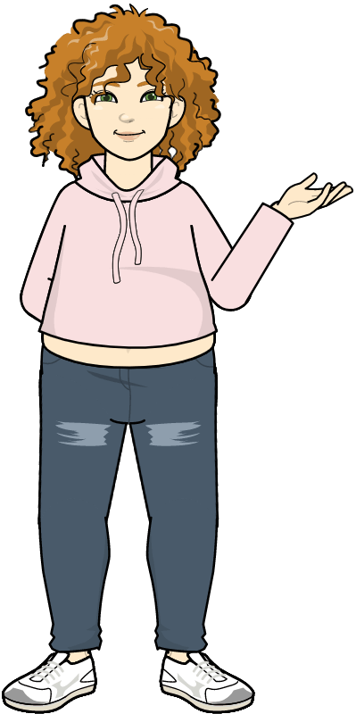
Attenzione ai rifiuti. BEWARE OF WASTE

Slide 6
Happy Mother’s Earth day

Slide 7
Adesso troviamo lo slogan della nostra storia
Il mio obiettivo
È…Liberare le spiagge dalla plastica
Ama la tua terra e
Proteggila
adesso
Non c’è più tempo!

Slide 9
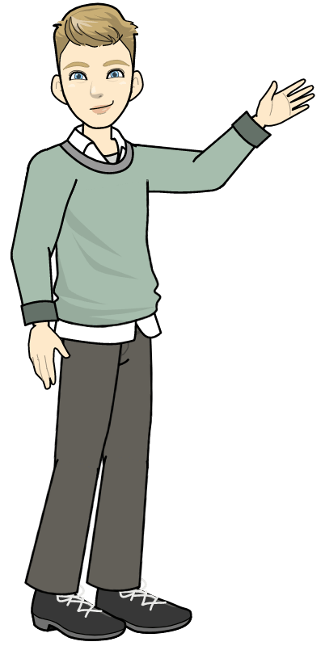
Earth day

Slide 10
Don’t waste water The future is in your hands

Slide 11
We care about bees They are essential to our future.

Slide 12
We care about bees

Slide 13
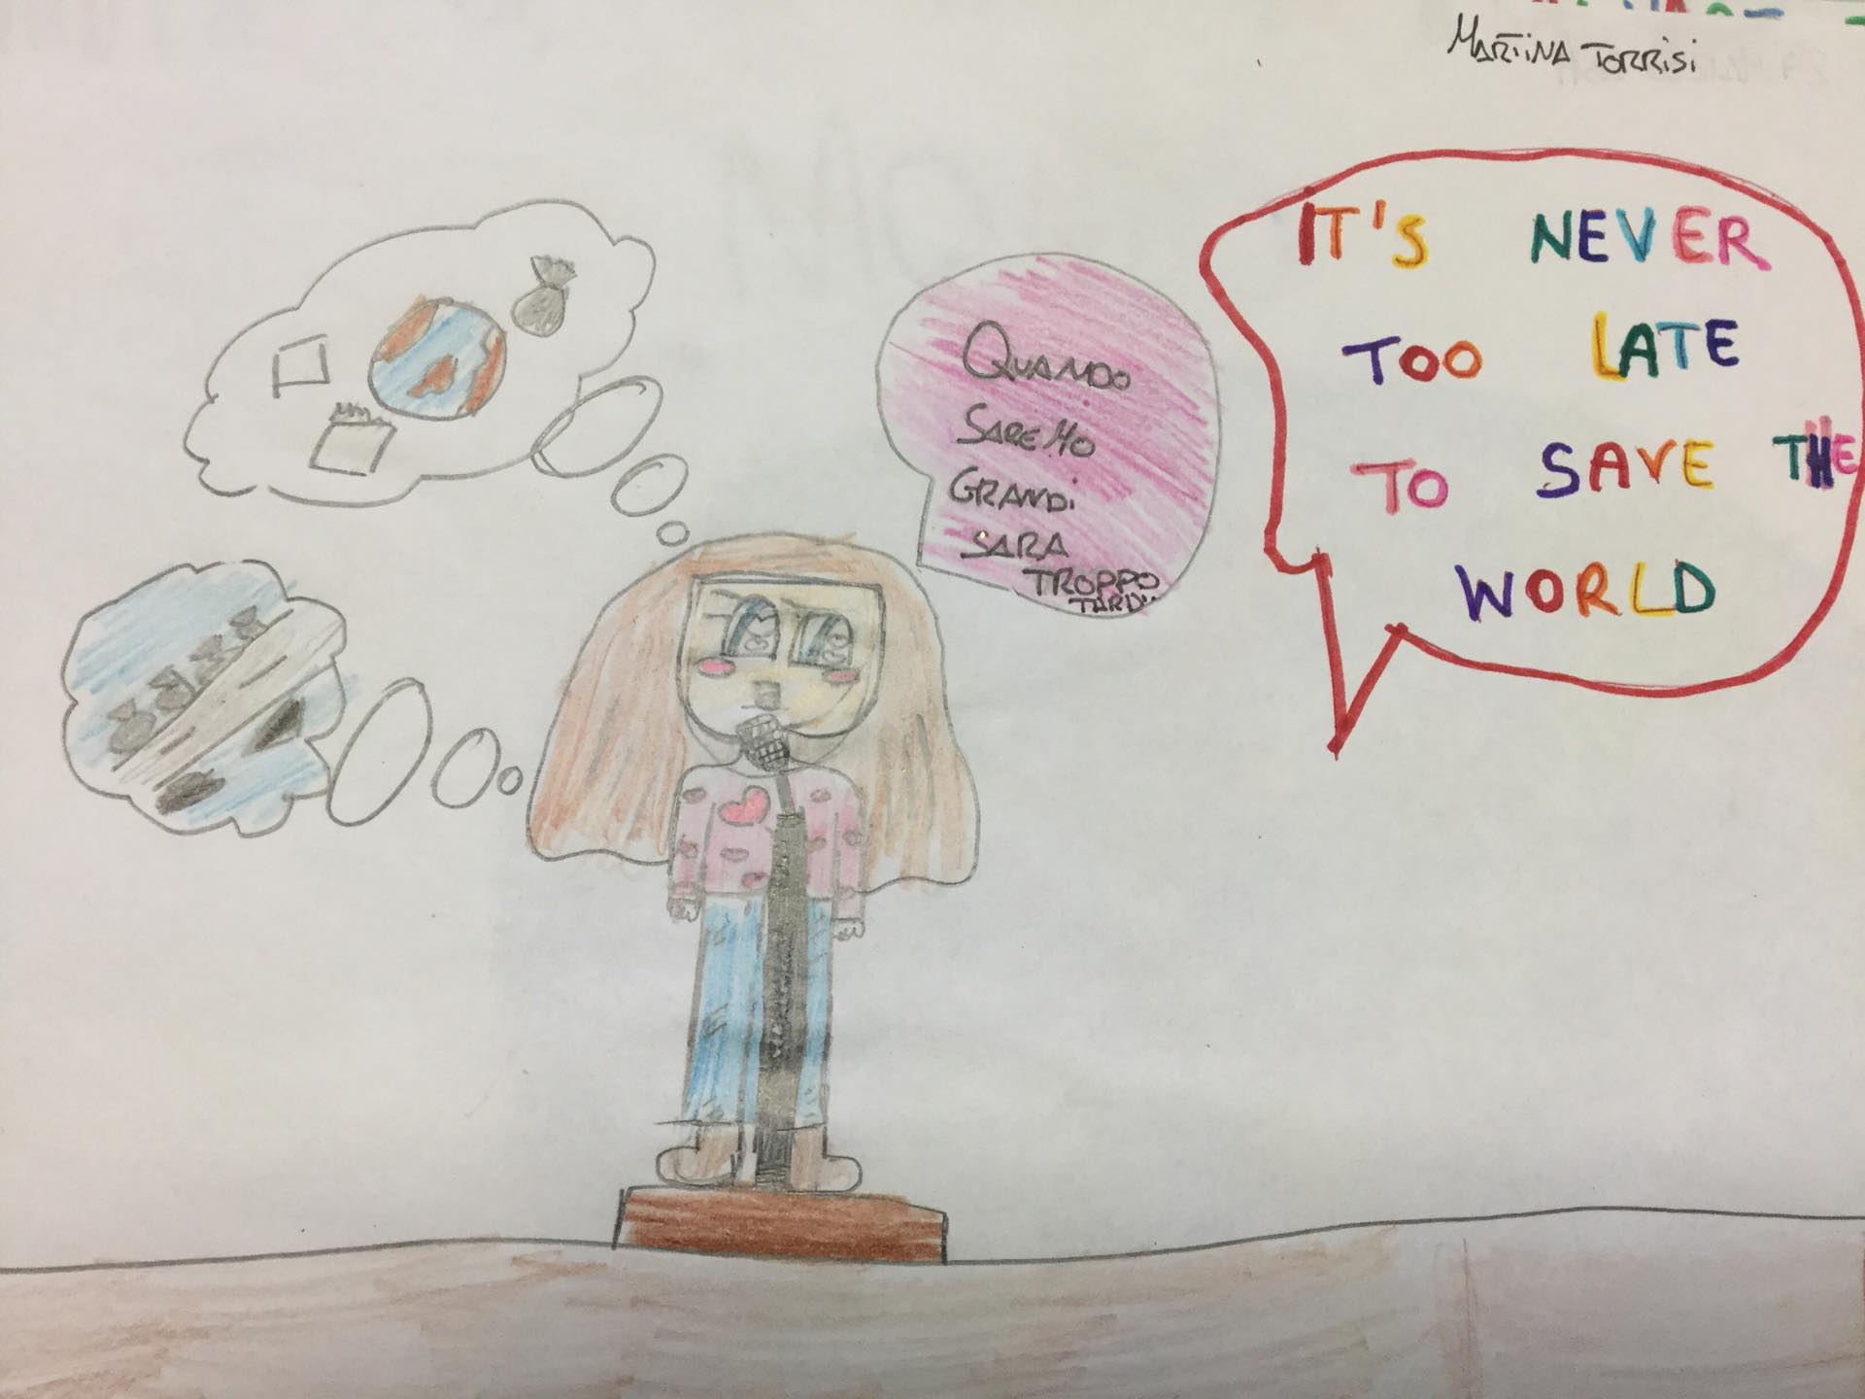
It’s never too late to save the world

Slide 14
We celebrated the 51° anniversary of Mother Earth

Slide 15
Let’s take care of the planet Care about it by hearth

Slide 16
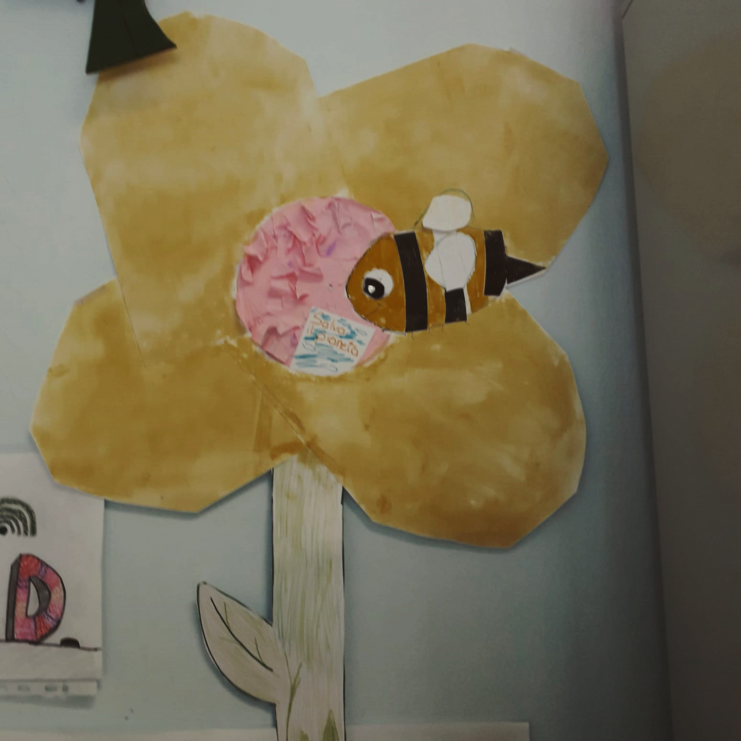
We talk about this problem We have to discuss about this problem and be activist

Slide 17
We must clean the planet with a broom

Slide 18
The planet is in our hands

Slide 19
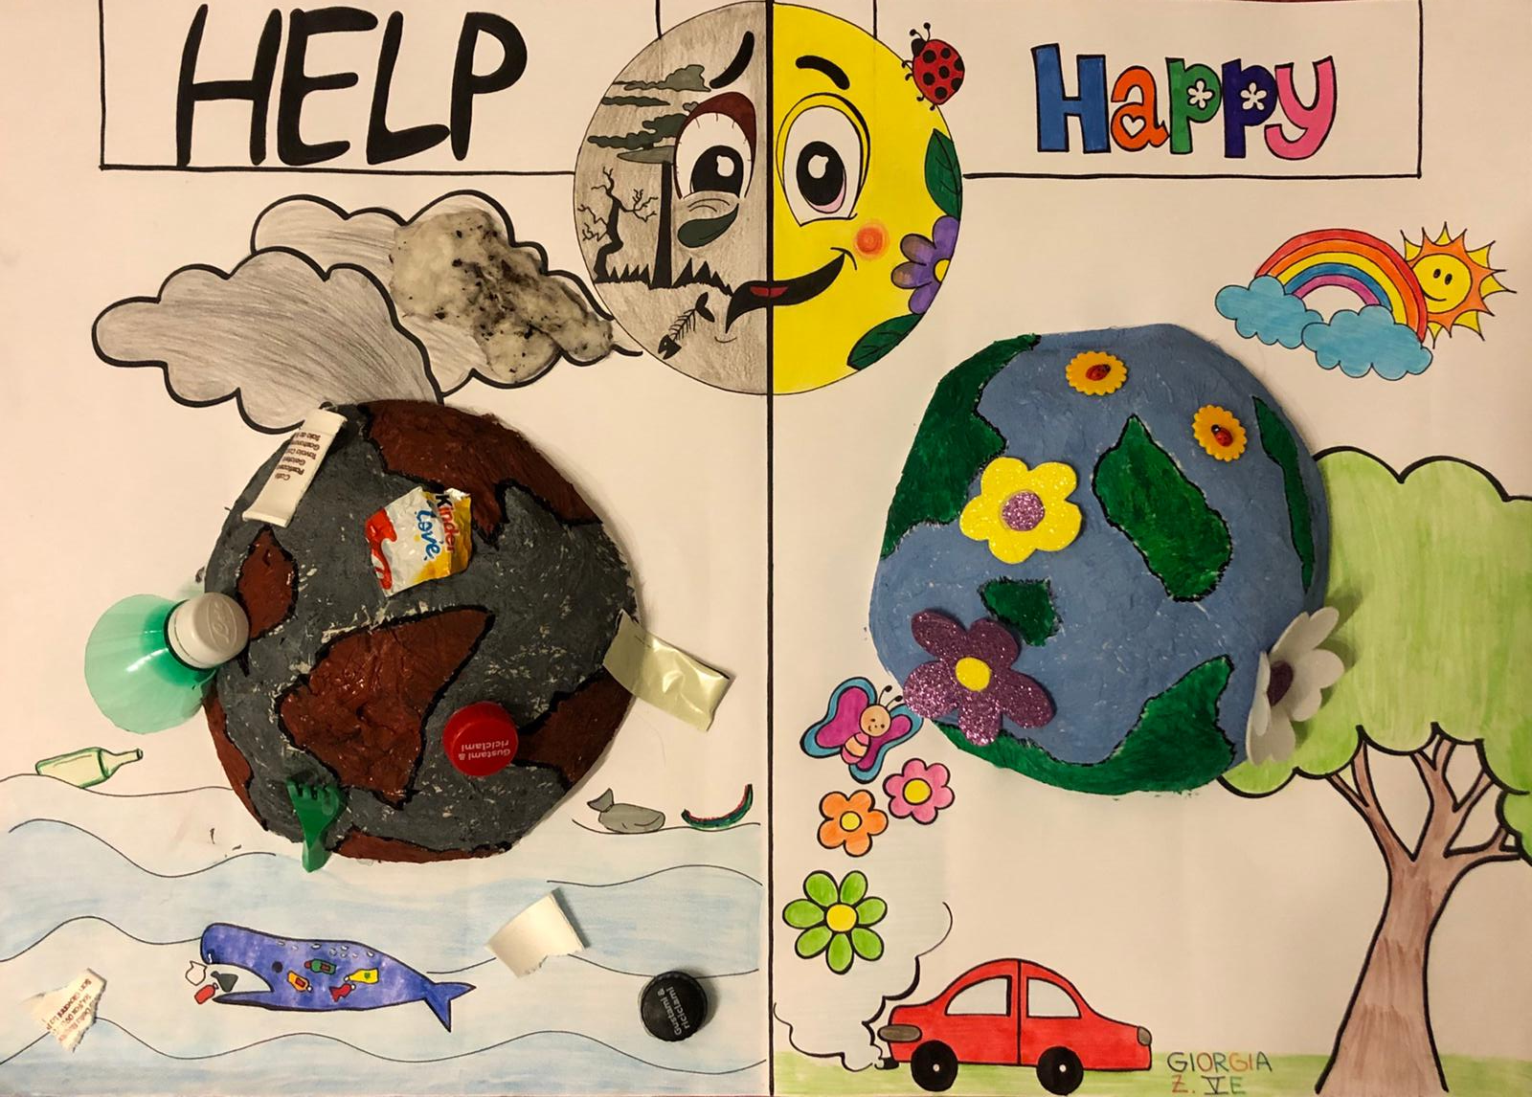
Giorgia created this 3D poster

Slide 20
FlipGrid

Slide 21
Earth day

Slide 22
Thanks for watching Class 5° E Mrs. Irene Confalone

